Slide 1
STUDENT PERFORMANCE PREDICTION USING MACHINE LEARNING
DATA MINING FINAL PROJECT
DATA DECODERS
Greeshma Namana - U24918180 Madhu Kiran Dadisetty – U53552106
Sasank Reddy Dodda - U81834293
Sravanth Reddipogu – U87860185
Shwetha Sunkara – U77094744
Vivekananda Redd - U34444641

Slide 2
Introduction
- MOOCs are a rapidly growing and immensely popular method of learning.
- They stand apart from traditional teaching by incorporating visuals, videos, and interactive elements to enhance engagement.
- Online platforms allow for data collection on student interactions and behavior, enabling early predictions of course completion.
- Early predictions empower course modifications and adjustments to improve completion rates.
- Our approach involves analyzing extensive student data to identify key factors contributing to course completion.
- The data drives the training of predictive models that successfully forecast course outcomes.
- We believe these successful models can significantly enhance the teaching and learning experience.

Slide 3

Problem Statement
Students Performance Prediction in Online Courses using ML Algorithms. How can universities improve MOOC completion rates?

Slide 4
Motivation
The motivation behind this initiative is to create a more effective and inclusive learning environment. By understanding what works for those who complete the course and addressing the challenges faced by dropouts, we aim to increase course completion rates and enhance overall learning outcomes. This data-driven approach helps us refine the course structure to better meet the needs of a diverse range of learners, ultimately improving the educational experience for everyone involved.

Slide 5
Business Question
How can we optimize the course structure to improve both course completion rates and overall learning outcomes, considering the performance of both course completers and dropouts?

Slide 6
About the Data Set​
The dataset used is called OpenUniversityLearningAnalytics.
This dataset contains information about 32,592 students and their interactions with a Virtual Learning Environment (VLE) across seven courses or xmodules.
courses.csv : This dataset includes a comprehensive list of modules along with their corresponding presentations.
assessment.csv: This dataset provides an extensive inventory of modules and their associated presentations.
vle.csv: This dataset contains details about the study materials available in the Virtual Learning Environment (VLE).
studentInfo.csv: This file contains demographic information about the students together with their results.
studentRegistration.csv: The file provides details about when students enrolled in the module presentation. It also records the un-registration date for those students who decided to unregister.
studentAssessment.csv: The document contains students' assessment results. If a student doesn't submit an assessment, there won't be a recorded result. Additionally, if the assessment result is absent in the system, it means the final exam submission is also missing.
studentVle.csv: The file provides details about how each student engages with the materials in the Virtual Learning Environment (VLE).

Slide 7
Data Mining Process
Data Preprocessing
Exploratory Data Analysis
Feature Selection
Model Selection
Model Training
SMOTE
Model Evaluation
Hyperparameter Tuning
Feature Importance

Slide 8
Data Preprocessing
Identifying Missing Values
We have rectified inaccurate values with the appropriate ones.
Removing Unnecessary columns
Merged few Columns
Feature Selection

Slide 9
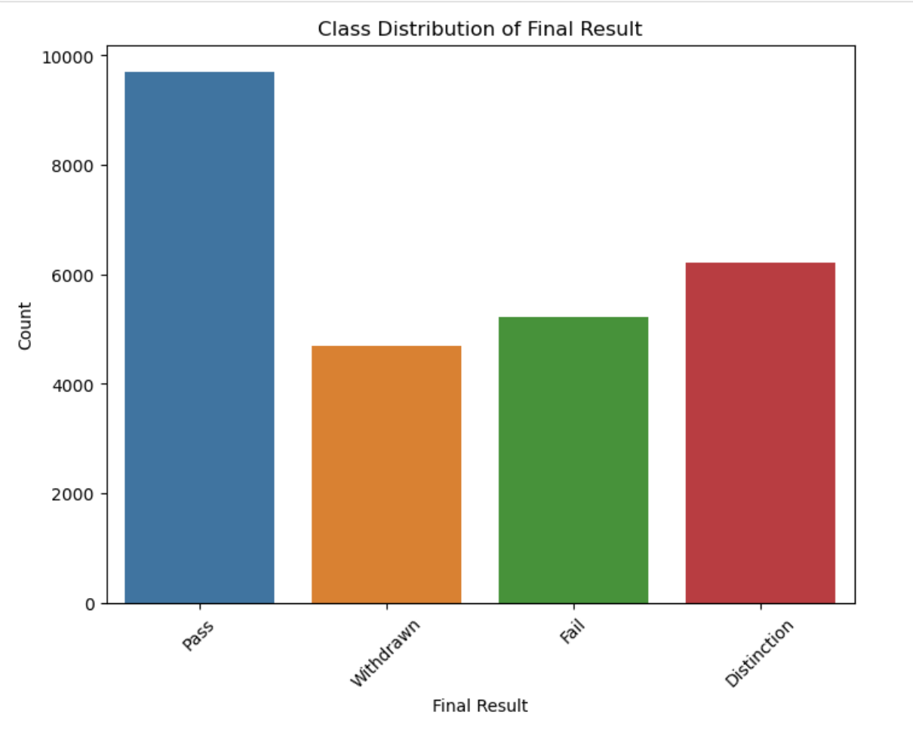
Exploratory Data Analysis (EDA)

Slide 10
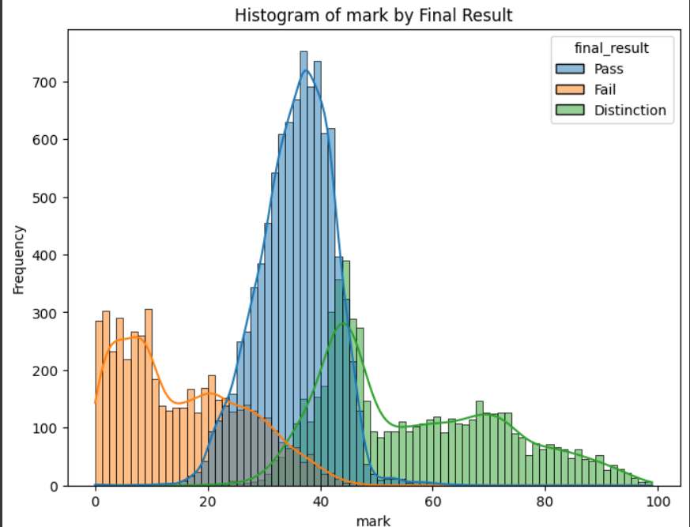
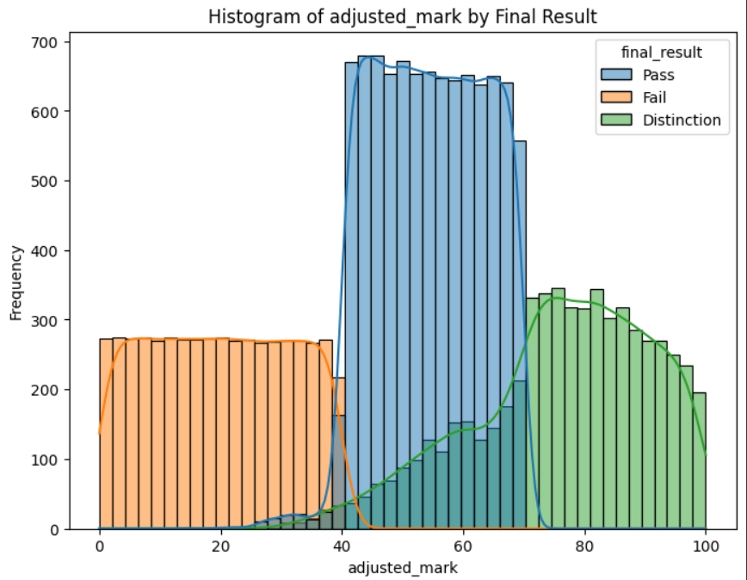

Slide 11
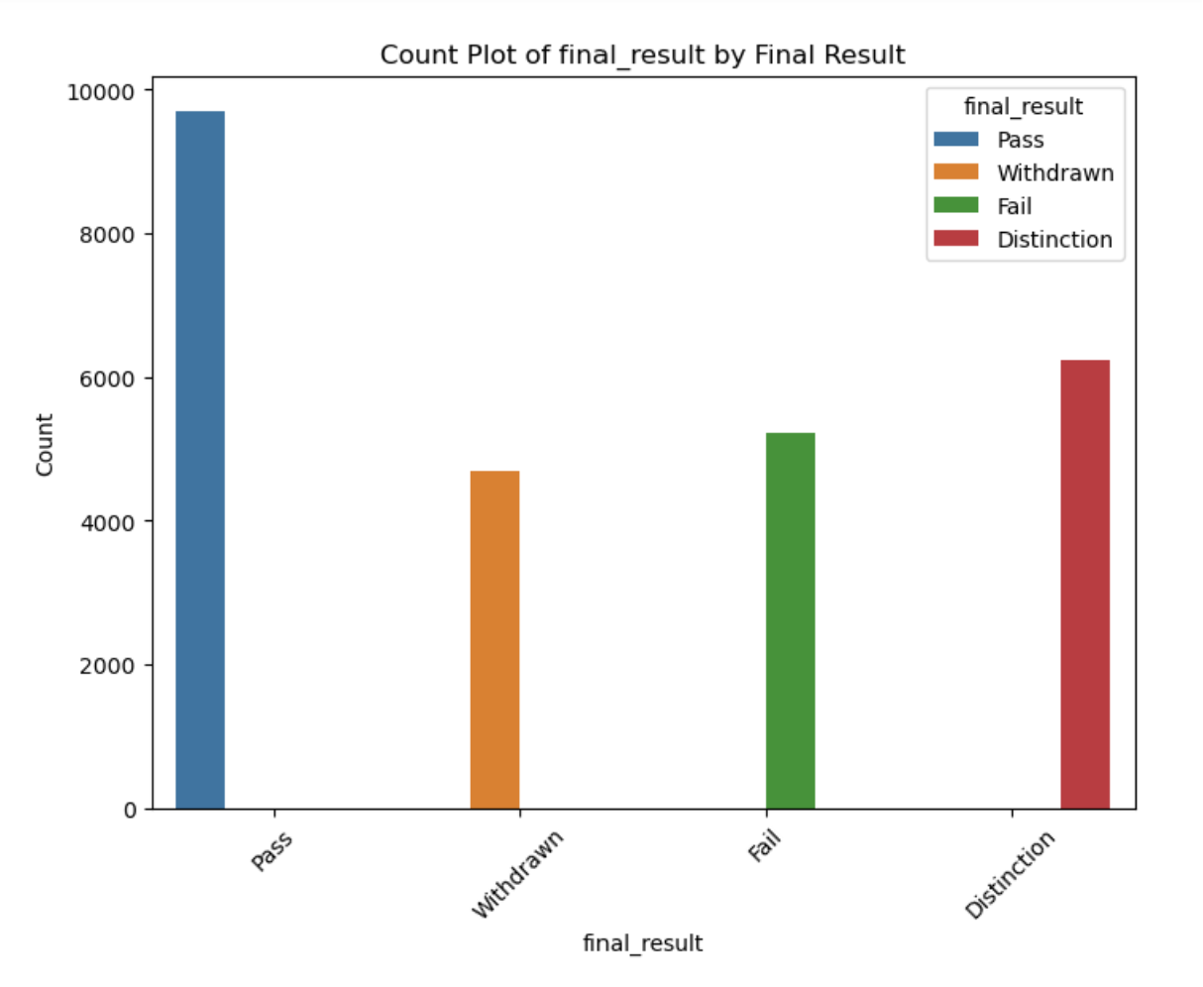
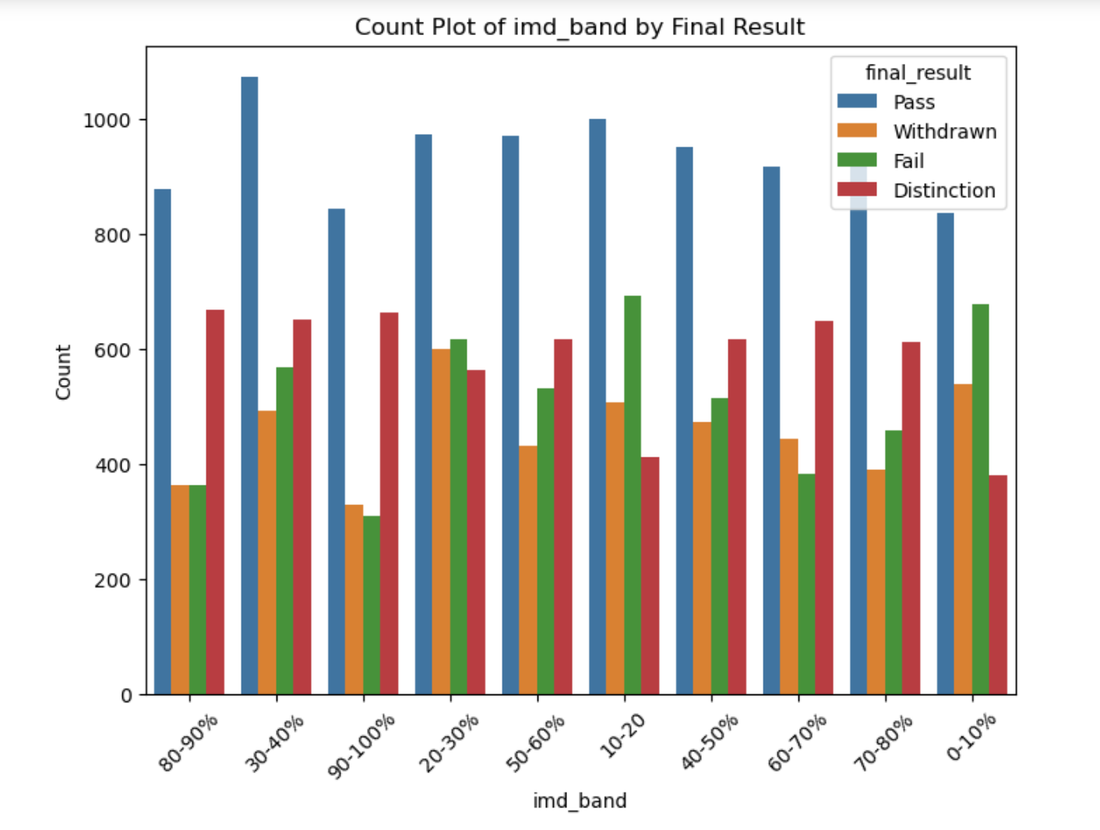
Categorical Features Count Plots

Slide 12
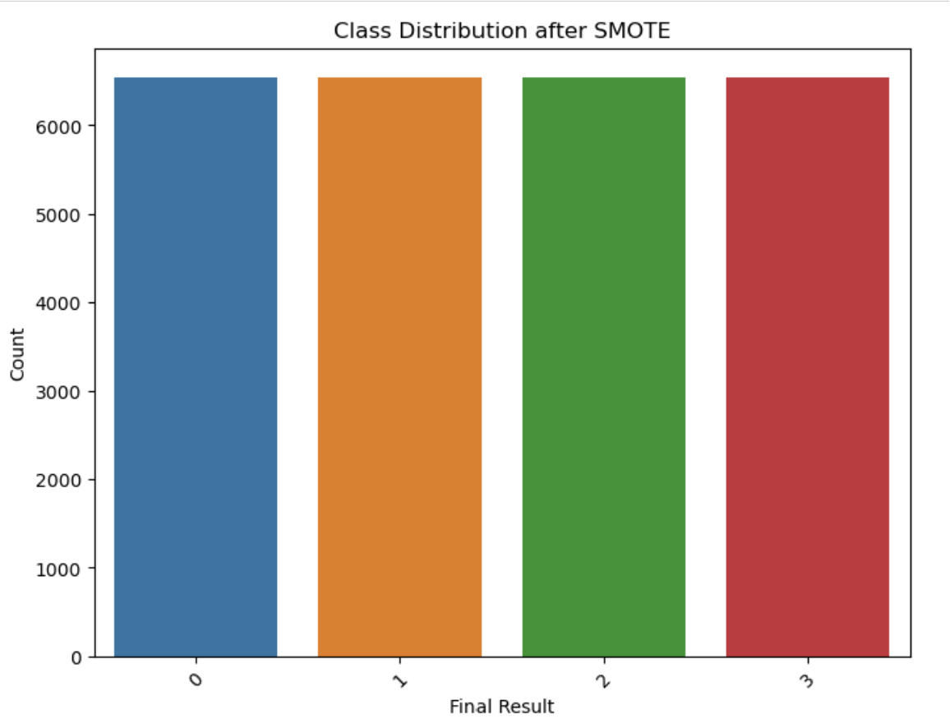
SMOTE Evaluation

Slide 13
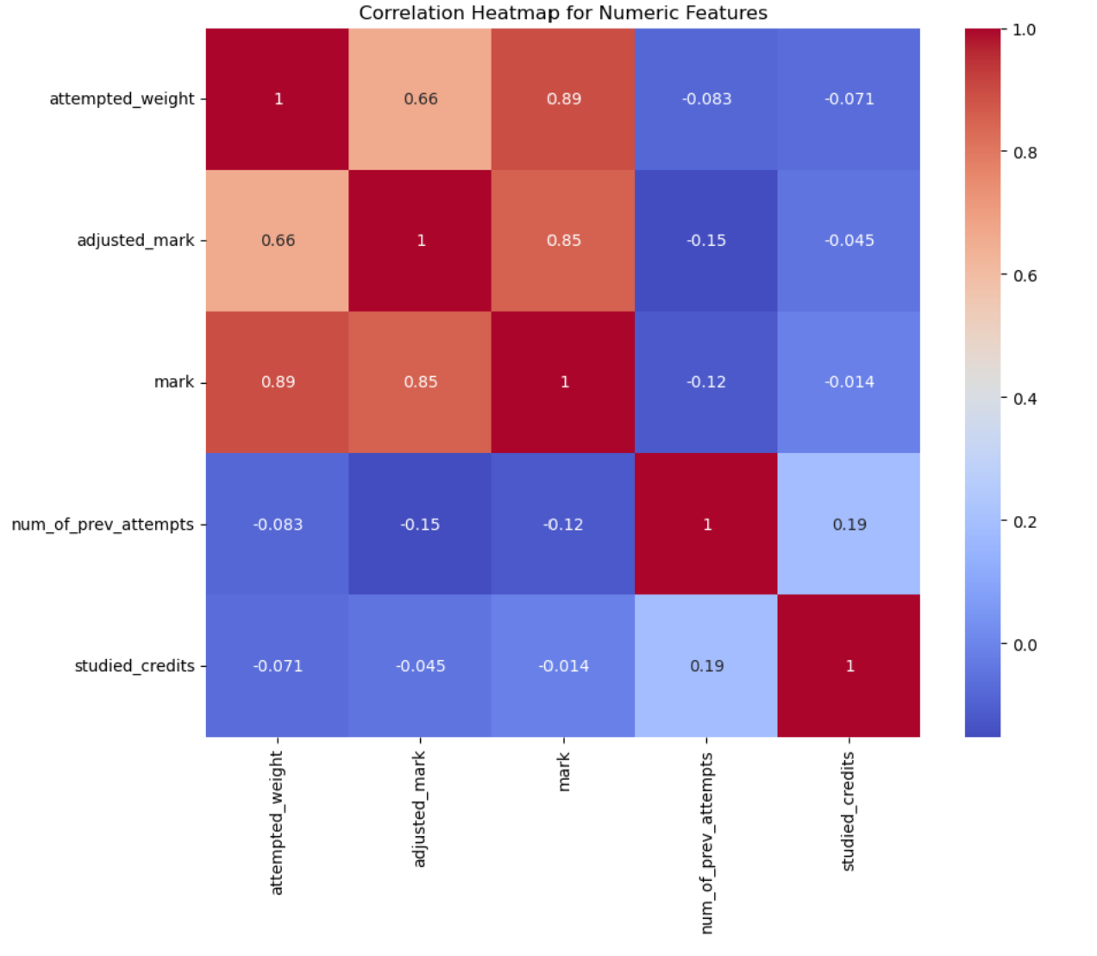
Correlation Heatmap for Numeric Features

Slide 14
Model Fitting
Selecting the Model
Split the data into Train and Test sets
Data Scaling
Fit the Model
Model Prediction by Metrics Used

Slide 15
Models Used for Prediction
KNN
Logistic Regression
Random Forest
Decision Tree

Slide 16
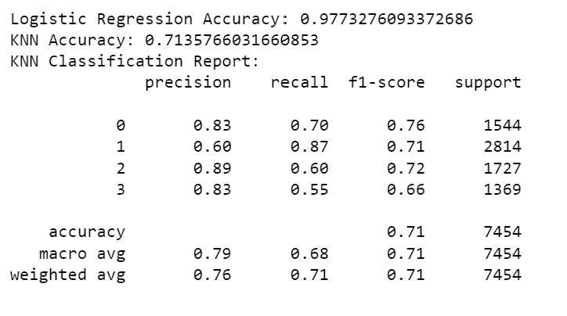
KNN vs Logistic Regression
Accuracy: 71.36%
Lower accuracy compared to other models
KNN's performance impacted by the choice of hyperparameters i.e number of neighbors.
Performs less well on this dataset compared to the other models.

Slide 17
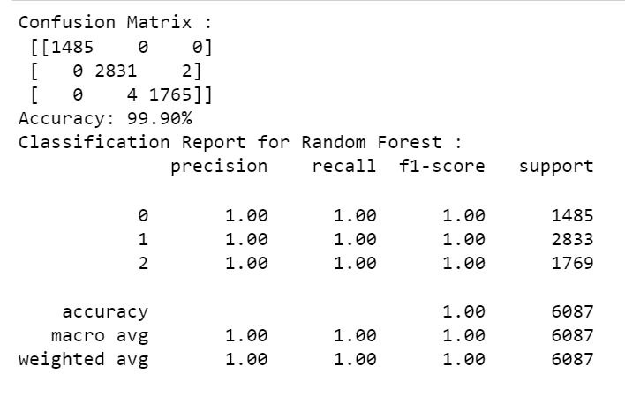
Random Forest
Accuracy: 99.90%
Ensemble methods with multiple decision trees, typically robust and less prone to overfitting.
Higher accuracy indicates strong predictive performance.

Slide 18
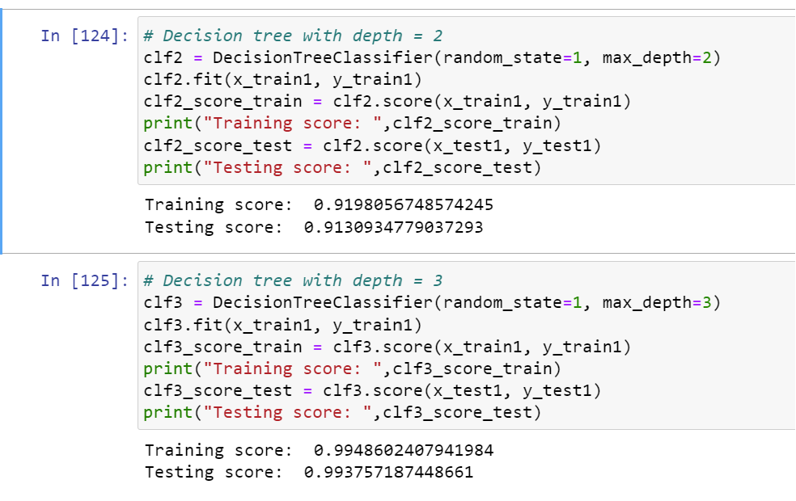
Decision Tree

Slide 19
Realtime Use Case Scenario​
The project's applications extend to various educational platforms, including:​
Online Course Providers: Organizations like Coursera, edX, and Udacity can use these insights to enhance their course offerings and increase student retention.​
Traditional Educational Institutions: Schools, colleges, and universities that offer online courses can leverage this project to improve the performance of their e-learning programs.​
Corporate Training: Companies that provide online training to employees can apply these techniques to enhance the effectiveness of their training programs.​
Educational Technology Companies: EdTech companies specializing in e-learning platforms and tools can integrate these predictive models to offer more effective solutions to educational institutions.​
In summary, this project's ability to predict student performance and enhance the learning experience has broad applications in the education sector, with the potential to improve course completion rates and student satisfaction while optimizing resource allocation.​

Slide 20
CONCLUSION
The models evaluated, including Random Forest, Logistic Regression, K-Nearest Neighbors, and Decision Tree, offer valuable insights for student performance analysis, with strengths such as high accuracy, interpretability, and in-depth decision analysis.
These models are instrumental in predicting student outcomes, identifying key factors influencing performance, and guiding interventions to enhance course completion rates.
As a business case study, the project's relevance lies in its potential to improve student outcomes, allocate resources effectively, foster data-driven decision-making, address ethical considerations, encourage collaboration, and promote continuous improvement in the educational context. It showcases the transformative power of data-driven strategies in elevating the teaching and learning experience and student success.

Slide 21
Future Enhancements
Ensemble Models: Consider creating ensemble models combine the strengths of multiple models. we can use techniques like stacking or bagging to improve prediction accuracy and reduce overfitting.
Ensure Robustness with Cross-Validation" K-fold cross-validation for model assessment and reducing overfitting.
Ensure Model Relevance" Monitor and evaluate models continuously for accuracy and relevance.
Collect Student Feedback" Use student input to improve models and interventions

Slide 22
Thank You

